Slide 1


Stock Price Predictor Using Machine Learning
A Web-Based Application for Financial Forecasting
By: Rian Qadir M00975827
Supervisor: Dr Andrew Lewis-Smith
13th April 2025

Slide 2
Outline
Background
Arguments & Problem statement
Aims & Objectives
Approach
Results
Conclusion
Future Work

Slide 3

Background
Forecasting stock prices has always been critical for investors to make a decision.
Traditional methods like Fundamental/Technical analysis have always struggled with market volatility and non-linear behaviors.
Shifting from the traditional methods to Machine Learning (ML) and Deep Learning (DL) methods is necessary to bring a revolution and make the predictions more accurate.
For my Web-App, I have used the Long Short-Term Memory (LSTM) method of ML models due to its promising capacity for learning long-term dependencies.

Slide 4

Arguments & Problem Statement
Problem:
Traditional Methods of forecasting the price are limited by their inability to handle rapid market changes and non-linearity of the price.
Reliance on historical averages and ratios does not adapt well to unpredictable market events.
The non-stationary, Noisy, and Volatile nature of Stocks and cryptocurrency data makes forecasting more difficult.
Solution:
Machine Learning models like LSTM can capture long-term dependencies and adapt to volatile data, which makes LSTM a strong candidate for time-series forecasting in finance.

Slide 5

Technologies used
• Programming Language: Python • Data Retrieval: Yahoo Finance API (via yfinance library) • Data Processing & Analysis: – Pandas & NumPy for data manipulation – Scikit-learn for data normalization (MinMaxScaler) and preprocessing • Deep Learning Framework: TensorFlow and Keras (for building and training LSTM models) • Visualization: Matplotlib and Plotly for plotting time-series and residuals • Web Deployment: Streamlit for the interactive web application • Model Optimization: EarlyStopping and dropout layers for regularization • Hardware: GPU acceleration for efficient training

Slide 6
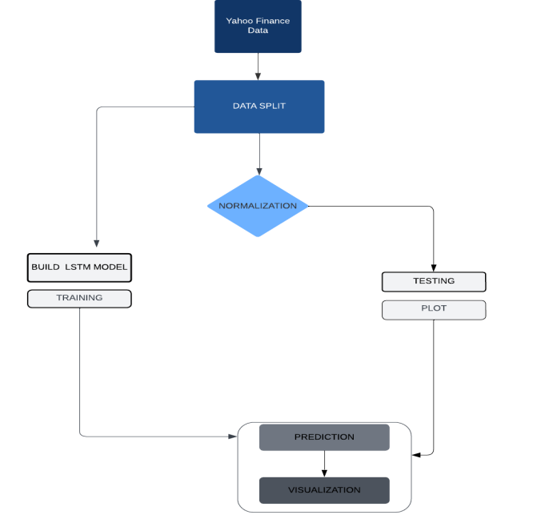
Aim & Objectives
Aim:
Develop, train, and deploy a scalable, web-based stock price prediction system using deep learning (LSTM networks).
Objectives:
Data Acquisition: Retrieve historical data from Yahoo Finance (for both stable equities like GOOG and volatile assets like BTC-USD)
Data Preprocessing:
Clean data (handle missing values with forward-fill, smooth outliers using IQR and rolling median).
Normalize using MinMax scaling and structure sequences via a sliding window (e.g., 60-day look-back).
Modeling:
Design a multi-layer LSTM architecture with dropout regularization to avoid overfitting.
Optimize hyperparameters (units, dropout rate, batch size, learning rate).
Evaluation: Validate performance using Mean Squared Error (MSE), Random Mean Square Error (RMSE), Mean Absolute Error (MAE), and residual analysis.
Deployment: Create an interactive web interface using Streamlit to visualize historical trends and forecast results.

Slide 7
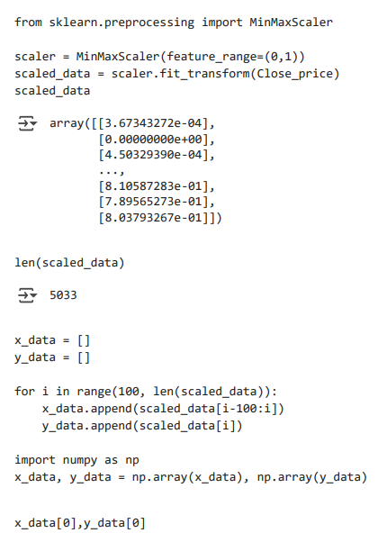
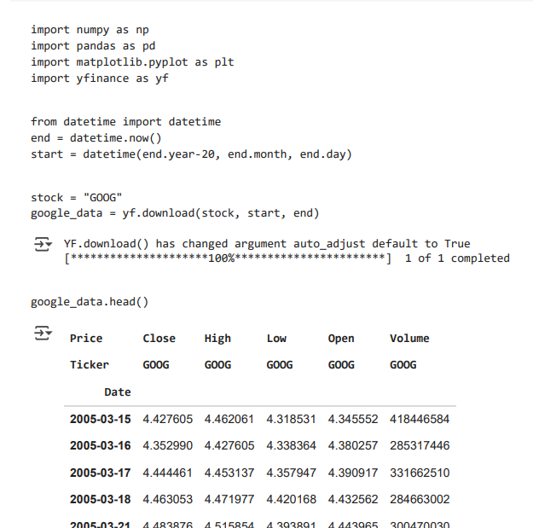
Approach: Data Collection & Preprocessing
Data Collection:
Source: Yahoo Finance's API (yfinance library) for both Google (GOOG) and Bitcoin (BTC-USD) data.
Features: Target 'Close' prices; include OHLC and volume for possible future extension.
Preprocessing Pipeline:
Cleaning: Drop or impute missing values (with forward-fill to maintain temporal coherence).
Outlier Handling: Identify outliers with the Interquartile Range (IQR) and smooth with a rolling median over a 7-day window.
Normalization: Scale data values to range from 0 to 1 using MinMaxScaler, which is necessary for LSTM efficiency.
Sequence Creation:
Convert time-series into supervised learning mode via sliding window (e.g., 60 days input → next day prediction).
Check reshaping into a 3D array for LSTM input.

Slide 8
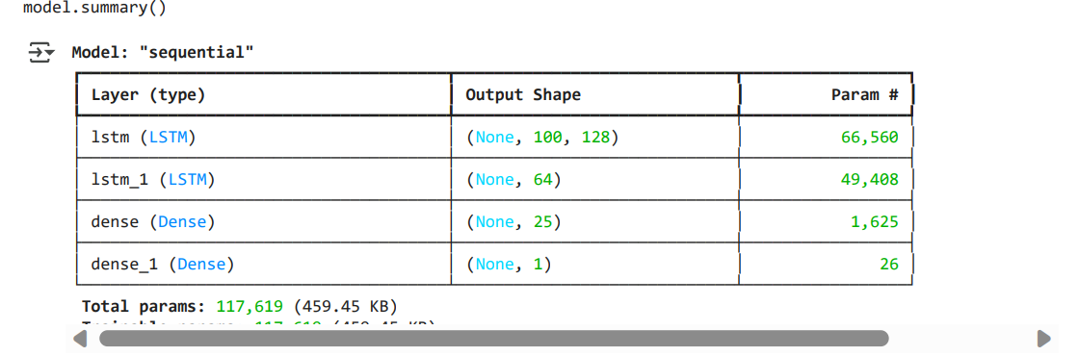
Approach: Model Design, Training & Evaluation
Model Architecture: – Two LSTM layers (each with 50 units) to capture both short-term and long-term dependencies. – Dropout layers (rate 0.2) included after each LSTM layer to mitigate overfitting. – Final Dense layer with a linear activation function for regression output.
Training Details: – Loss Function: Mean Squared Error (MSE) to penalize larger errors. – Optimizer: Adam for adaptive learning rate adjustment. – Data Splitting: • Chronologically partition data (80% training, 20% testing) to simulate real-world forecasting.
Evaluation Metrics: – RMSE and MAE to quantify prediction errors. – Visual analysis: Time-series plots comparing predicted vs. actual prices and residual distribution.

Slide 9
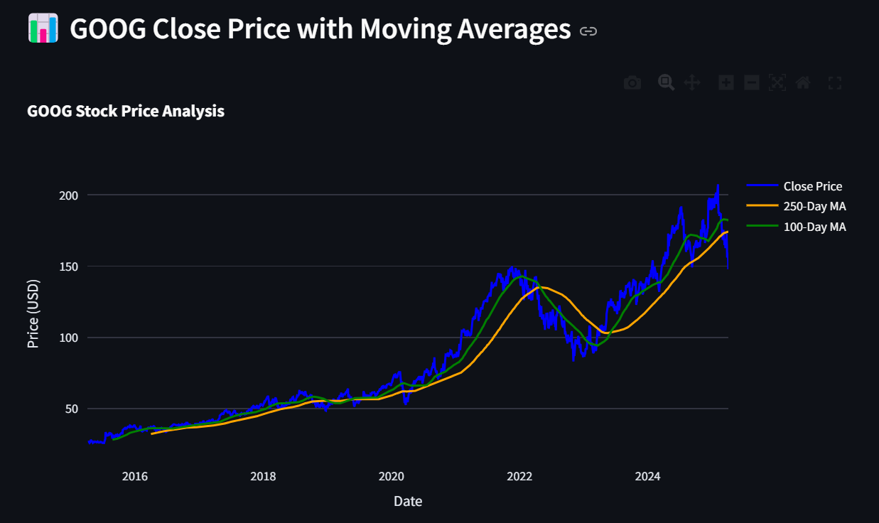
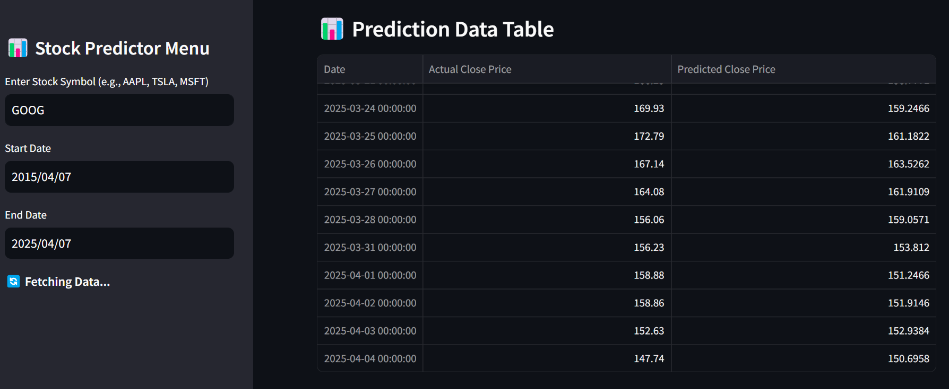
Results: Performance and Visual Analysis
• Google Stock Predictions: – Achieved a moderate RMSE, indicating an error margin that is acceptable given the price scale. – Predicted trends closely follow actual data with smooth trend lines. • Bitcoin Predictions: – Moderate RMSE due to intrinsic volatility, yet the model captures the overall trend direction. – Visual plots show LSTM’s strength in trend detection but some lag in sudden spikes or drops. • Residual Analysis: – Residuals are evenly distributed, confirming that the model does not exhibit significant bias except during extreme market events. • Comparative Insight: – Baseline methods (e.g., Moving Average models) underperform relative to LSTM, particularly during rapid market shifts.

Slide 10
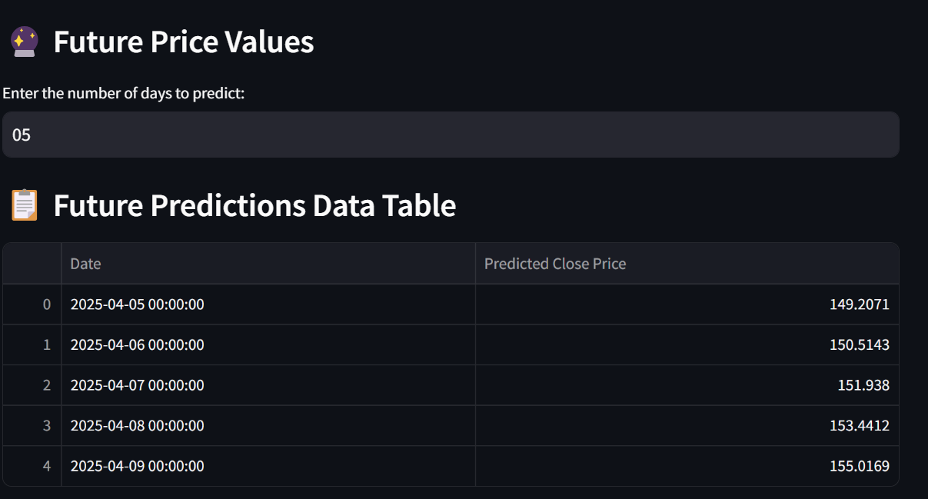
Results: Comparative Analysis & Forecasting Horizon
• Comparison with Baseline Models: – LSTM outperforms a simple Moving Average (MA) model, especially in volatile conditions. • Recursive Forecasting: – Recursive forecasts (feeding predictions back as input) work well short-term (1-day ahead) but errors compound over longer horizons (e.g., 5-day ahead). • Key Observations: – The model is more conservative in predicting sudden large changes, reflecting its design to smooth out noise. – Directional accuracy is high, which is valuable for momentum-based trading strategies even if exact price prediction is challenging.

Slide 11
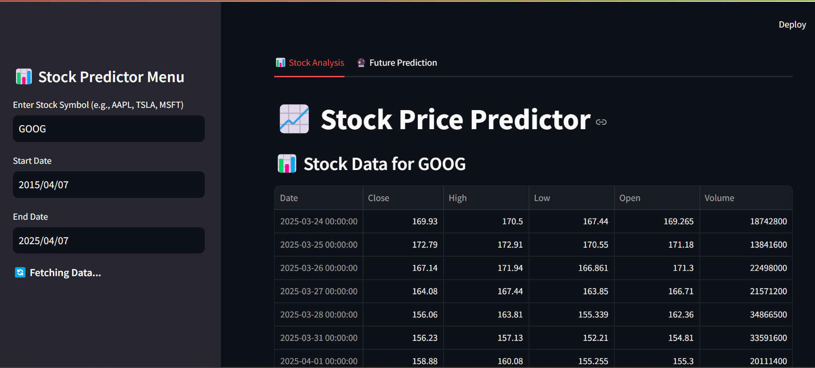
Conclusion
Summary of Achievements: – Successfully built a web-based stock price prediction system using LSTM networks. – Demonstrated that LSTMs effectively capture sequential dependencies in financial time-series data. – Developed a practical tool with interactive visualizations for both research and potential trading support.
Strengths: – High accuracy in stable environments (e.g., Google stock) and reasonable performance in volatile conditions (e.g., Bitcoin).

Slide 12
Conclusion
• Limitations Identified: – The model is based solely on historical closing prices (univariate), missing exogenous inputs like trading volume, sentiment, or macroeconomic indicators. – Difficulty in capturing abrupt market shocks and extreme volatility, particularly for assets like Bitcoin. – Lack of interpretability; future work could incorporate explainability methods (e.g., SHAP) to demystify LSTM predictions. • Overall Evaluation: – The approach is robust and practical for short-term forecasting. – Provides a solid foundation for extending to more complex, multivariate forecasting models.

Slide 13

Future direction
• Data Enhancements: – Incorporate additional variables such as technical indicators, trading volume, and sentiment analysis from news and social media. • Model Improvements: – Experiment with hybrid architectures (e.g., CNN-LSTM, attention mechanisms, or transformers) to improve prediction accuracy and responsiveness. – Employ advanced hyperparameter tuning techniques for model refinement. • Deployment and Scalability: – Expand the web application to handle real-time data streams and API integration for live updates. – Improve the user interface for enhanced decision support and interactive analytics. • Explainability and Trust: – Integrate interpretability frameworks to provide insights into model decisions and increase user trust.

Slide 14
Thankyou

